Slide 1
Introduction to DBMS

Slide 2
목적
Normalization은 왜 필요한가?
3rd Normalization에 대한 이해
Table간의 관계에 대한 이해

Slide 3
제 3 장 정규화 이론
정규화의 개념
함수적 종속과 정규화
  함수적 종속
  1차 정규형
  2차 정규형
  3차 정규형
  보이스-코드 정규형
  4차 정규형
  5차 정규형
정규화된 관계의 통합

Slide 4
Database Normalization
Database normalization is the process of removing redundant data from your tables in to improve storage efficiency, data integrity, and scalability.
Normalization is a process that “improves” a database design by generating relations that are of higher normal forms.
Normalization generally involves splitting existing tables into multiple ones, which must be re-joined or linked each time a query is issued.
The objective of normalization: “to create relations where every dependency is on the key, the whole key, and nothing but the key”.

Slide 5
History
Edgar F. Codd first proposed the process of normalization and what came to be known as the 1st normal form in his paper A Relational Model of Data for Large Shared Data Banks Codd stated:
“There is, in fact, a very simple elimination procedure which we shall call normalization. Through decomposition nonsimple domains are replaced by ‘domains whose elements are atomic (nondecomposable) values.’”

Slide 6
Normal Form
Edgar F. Codd originally established three normal forms: 1NF, 2NF and 3NF. There are now others that are generally accepted, but 3NF is widely considered to be sufficient for most applications. Most tables when reaching 3NF are also in BCNF (Boyce-Codd Normal Form).

Slide 7
Table 1
Title | Author1 | Author2 | ISBN | Subject | Pages | Publisher
Database System Concepts | Abraham Silberschatz | Henry F. Korth | 0072958863 | MySQL, Computers | 1168 | McGraw-Hill
Operating System Concepts | Abraham Silberschatz | Henry F. Korth | 0471694665 | Computers | 944 | McGraw-Hill

Slide 8
Table 1 problems
This table is not very efficient with storage.
This design does not protect data integrity.
Third, this table does not scale well.

Slide 9
First Normal Form
In our Table 1, we have two violations of First Normal Form:
First, we have more than one author field,
Second, our subject field contains more than one piece of information. With more than one value in a single field, it would be very difficult to search for all books on a given subject.

Slide 10
First Normal Table
Table 2
Title | Author | ISBN | Subject | Pages | Publisher
Database System Concepts | Abraham Silberschatz | 0072958863 | MySQL | 1168 | McGraw-Hill
Database System Concepts | Henry F. Korth | 0072958863 | Computers | 1168 | McGraw-Hill
Operating System Concepts | Henry F. Korth | 0471694665 | Computers | 944 | McGraw-Hill
Operating System Concepts | Abraham Silberschatz | 0471694665 | Computers | 944 | McGraw-Hill

Slide 11
Second Normal Form
As the First Normal Form deals with redundancy of data across a horizontal row, Second Normal Form (or 2NF) deals with redundancy of data in vertical columns.
As stated earlier, the normal forms are progressive, so to achieve Second Normal Form, the tables must already be in First Normal Form.
The Book Table will be used for the 2NF example

Slide 12
Subject Table
Subject_ID | Subject
1 | MySQL
2 | Computers
Author Table
Author_ID | Last Name | First Name
1 | Silberschatz | Abraham
2 | Korth | Henry
Book Table
ISBN | Title | Pages | Publisher
0072958863 | Database System Concepts | 1168 | McGraw-Hill
0471694665 | Operating System Concepts | 944 | McGraw-Hill

Slide 13
Relationships
Book_Author Table
ISBN | Author_ID
0072958863 | 1
0072958863 | 2
0471694665 | 1
0471694665 | 2
Book_Subject Table
ISBN | Subject_ID
0072958863 | 1
0072958863 | 2
0471694665 | 2

Slide 14
2NF Table
Publisher Table
Publisher_ID | Publisher Name
1 | McGraw-Hill
Book Table
ISBN | Title | Pages | Publisher_ID
0072958863 | Database System Concepts | 1168 | 1
0471694665 | Operating System Concepts | 944 | 1

Slide 15
Third Normal Form
Third normal form (3NF) requires that there are no functional dependencies of non-key attributes on something other than a candidate key.
A table is in 3NF if all of the non-primary key attributes are mutually independent
There should not be transitive dependencies

Slide 16
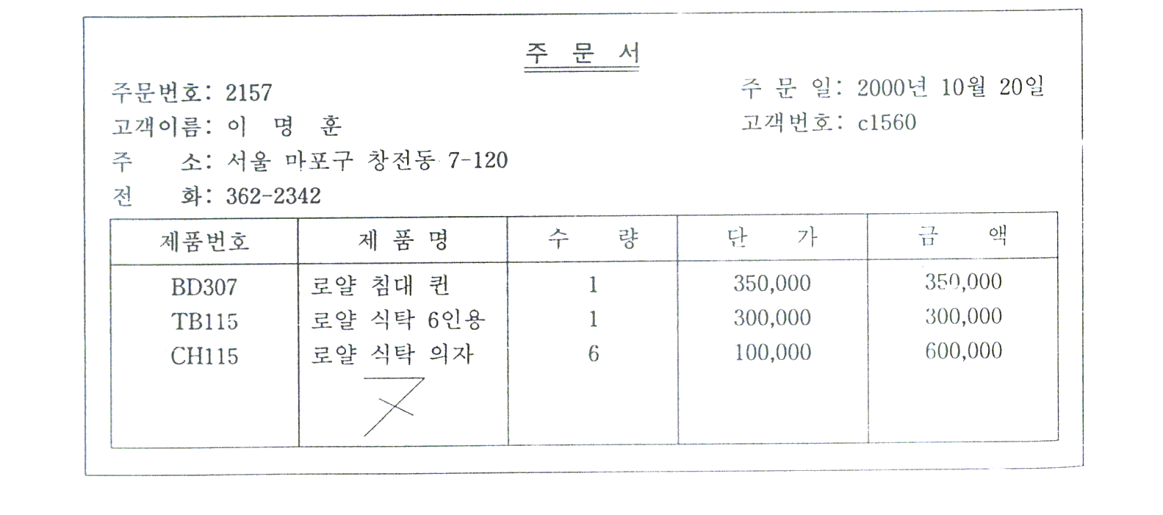
명문가구의 고객주문서

Slide 17
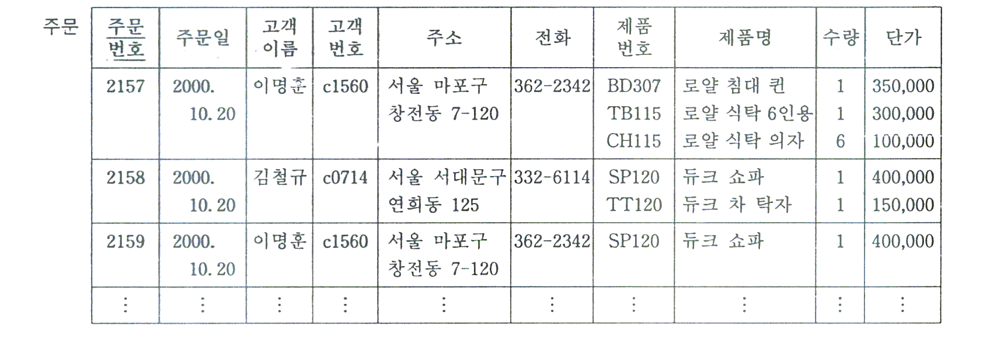
비정규형의 관계
주문(주문번호, 주문일, 고객명, 고객번호, 주소, 전화,
{제품번호, 제품명, 수량, 단가})
문제점: 관계형 데이터 모델의 본질적 제약 위반

Slide 18
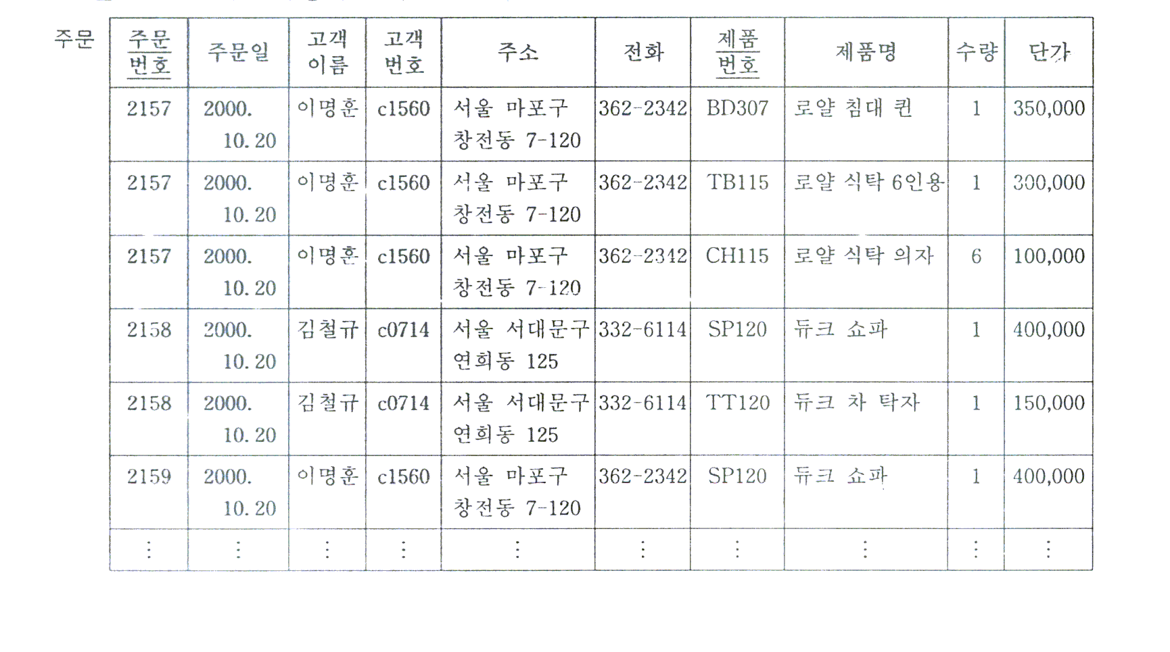
1차 정규형
정의: 원자값만 갖는 타플로 구성된 관계
  1차 정규형의 관계
주문(주문번호, 주문일, 고객명, 고객번호, 주소, 전화, 제품번호, 제품명, 수량, 단가)

Slide 19
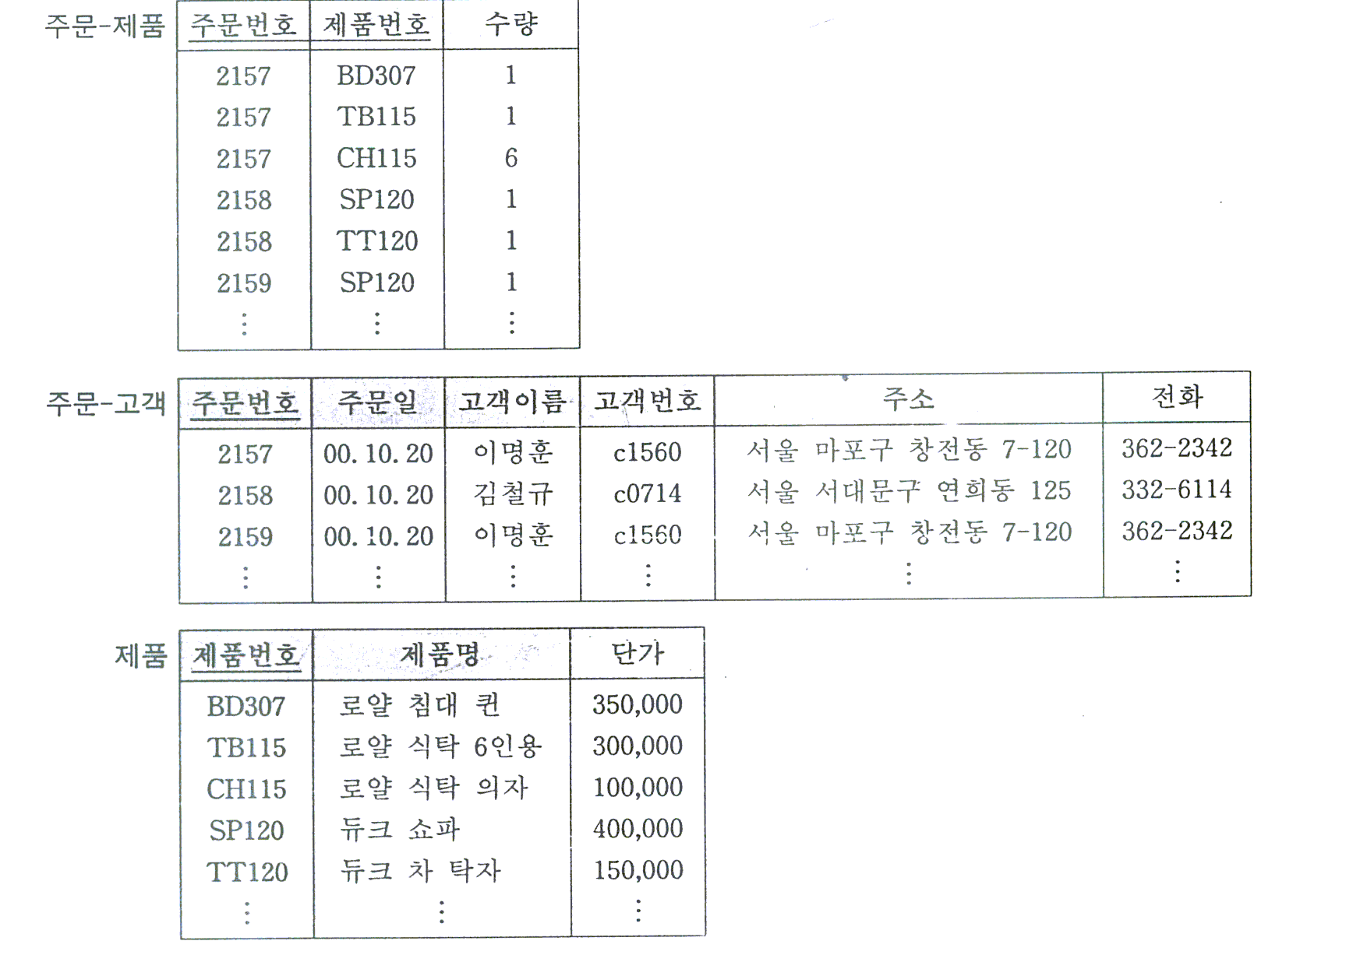
2차 정규형
  2차 정규형의 관계
주문-제품(주문번호, 제품번호, 수량)
주문-고객(주문번호, 주문일, 고객명, 고객번호, 주소, 전화)
제품(제품번호, 제품명, 단가)

Slide 20
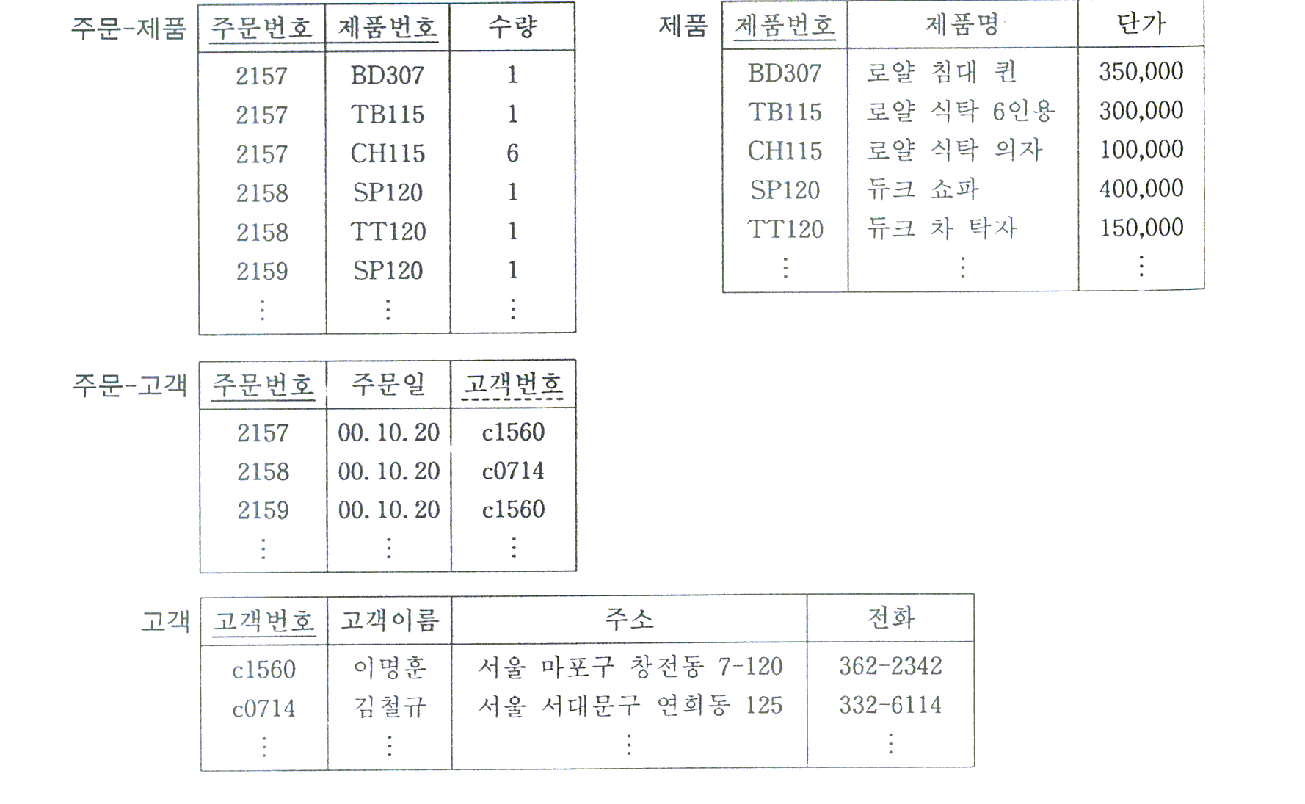
3차 정규형으로 전환된 고객 주문서

Slide 21
정규화된 관계의 통합 Check Point
여러 사용자 관점을 하나의 관점으로 통합
  이음 동의어: 동일 속성을 다른 이름으로 부르고 있지는 않은가?
  동음 이의어: 다른 속성을 같은 이름으로 부르고 있지는 않은가?
  이전 종속: 두 관계를 통합할 때 이전 종속이 발생하지는 않는가?
  일반화: 유사한 관계를 일반화할 수 있는가?

Slide 22
Functional Dependencies
EmpNum
EmpEmail
EmpFname
EmpLname
123
jdoe@abc.com
John
Doe
456
psmith@abc.com
Peter
Smith
555
alee1@abc.com
Alan
Lee
633
pdoe@abc.com
Peter
Doe
787
alee2@abc.com
Alan
Lee
If EmpNum is the PK then the FDs:
EmpNum → EmpEmail
EmpNum → EmpFname
EmpNum → EmpLname
must exist.
91.2914

Slide 23
Functional Dependencies
EmpNum → EmpEmail
EmpNum → EmpFname
EmpNum → EmpLname
3 different ways you might see FDs depicted
EmpEmail
EmpNum
EmpFname
EmpLname
EmpNum EmpEmail EmpFname EmpLname
91.2914

Slide 24
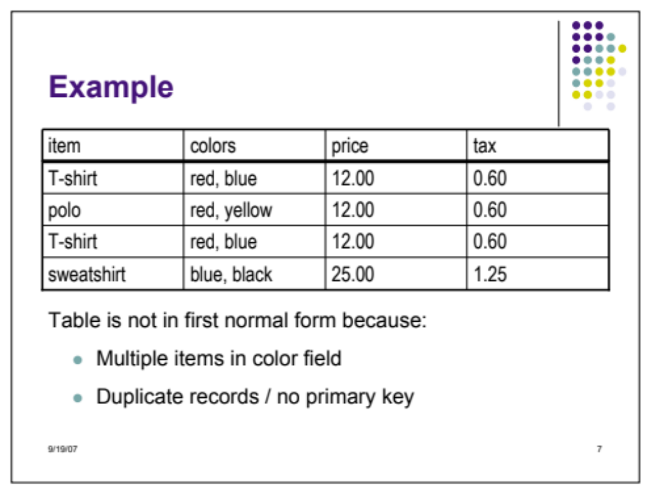
Original Table

Slide 25
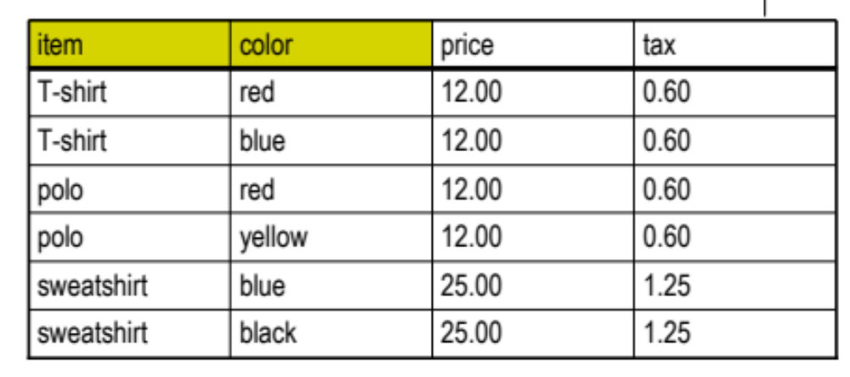
1NF

Slide 26
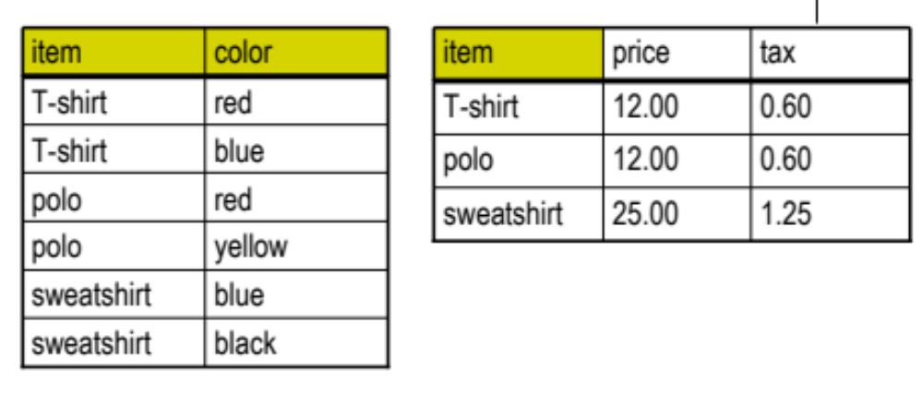
2NF

Slide 27
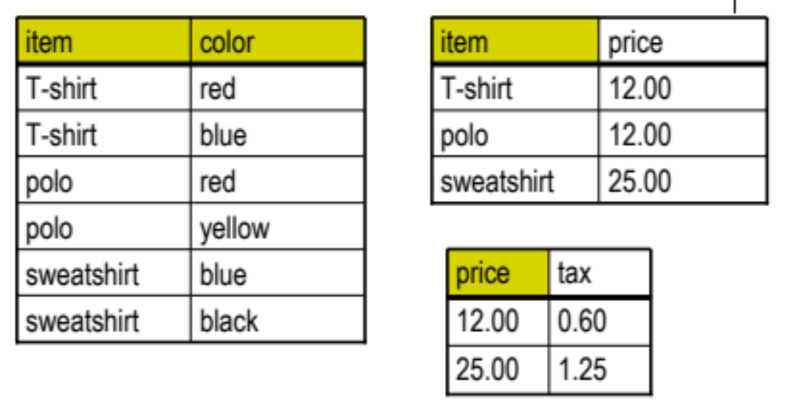
3NF

Slide 28
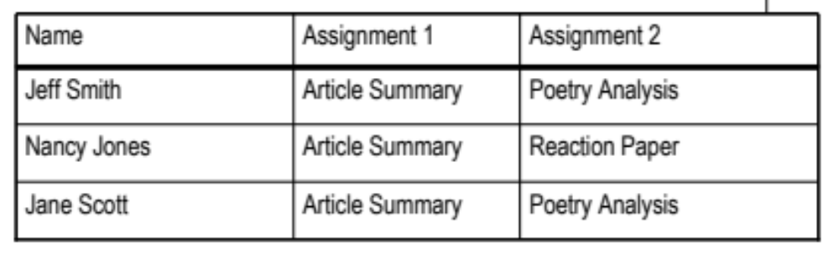
Original Table

Slide 29
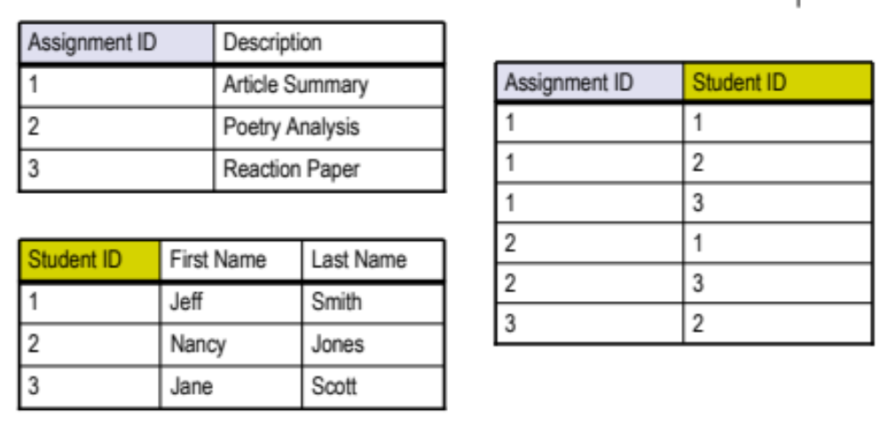
3NF

